Slide 1
Ethical Hacking and Incident Response CT080-3-2 (Version VE1)
Cryptography

Slide 2
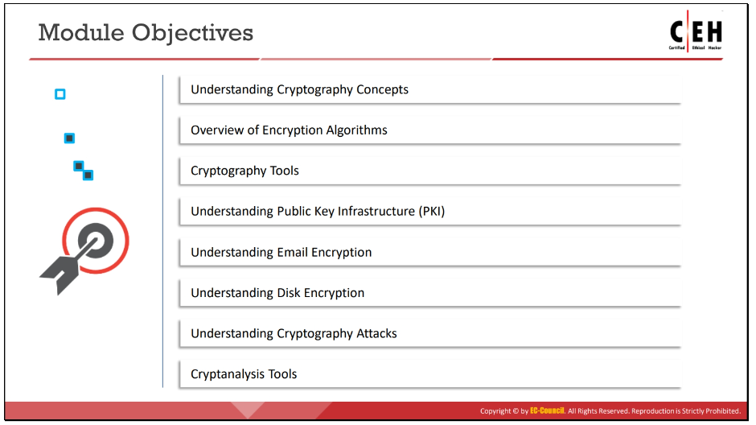
Topic & Structure of The Lesson
Introduction
Cryptography
Symmetric encryption
Asymmetric encryption
Hash function
Authentication

Slide 3
Learning Outcomes
At the end of this topic, You should be able to
Describe cryptography concepts
Understand different encryption algorithms
Use different cryptography tools
Describe public key infrastructure (PKI)
Apply email encryption
Apply disk encryption
Describe various cryptography attacks
Use different cryptanalysis tools

Slide 4
Key Terms You Must Be Able To Use
If you have mastered this topic, you should be able to use the following terms correctly in your assignments and exams:
RSA
Diffie-Hellman
El Gamal
PKI
AES
MD5
SHA1, SHA2

Slide 5
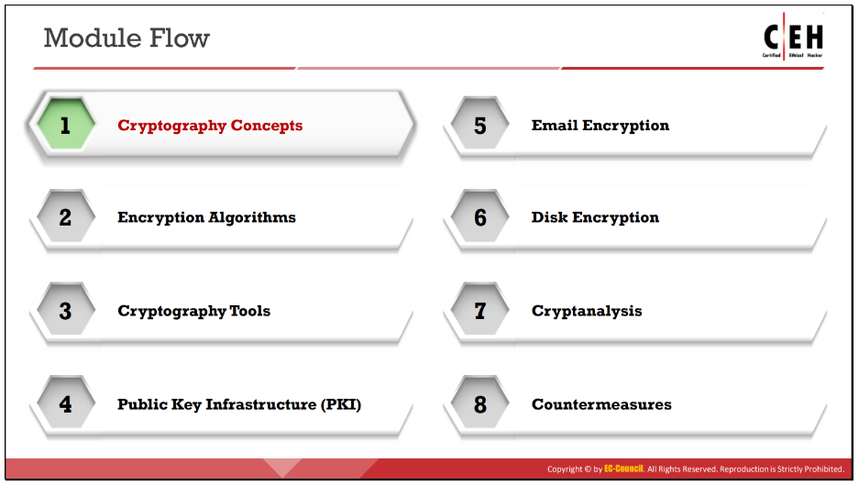
Module Flow
Notes:
With the increasing adoption of the Internet (World Wide Web) for business and personal communication, securing sensitive information such as credit card details, PINs, bank account numbers, and private messages is becoming increasingly important, albeit more difficult to achieve. Today’s information-based organizations extensively use the Internet for e-commerce, market research, customer support, and a variety of other activities. Data security is critical to online business and communication privacy.
Cryptography and cryptographic (“crypto”) systems help in securing data against interception and compromise during online transmissions. This module provides a comprehensive understanding of different cryptosystems and algorithms, one-way hash functions, public-key infrastructures (PKIs), and the different ways in which cryptography can ensure the privacy and security of online communication. It also covers various tools used to encrypt sensitive data.

Slide 6
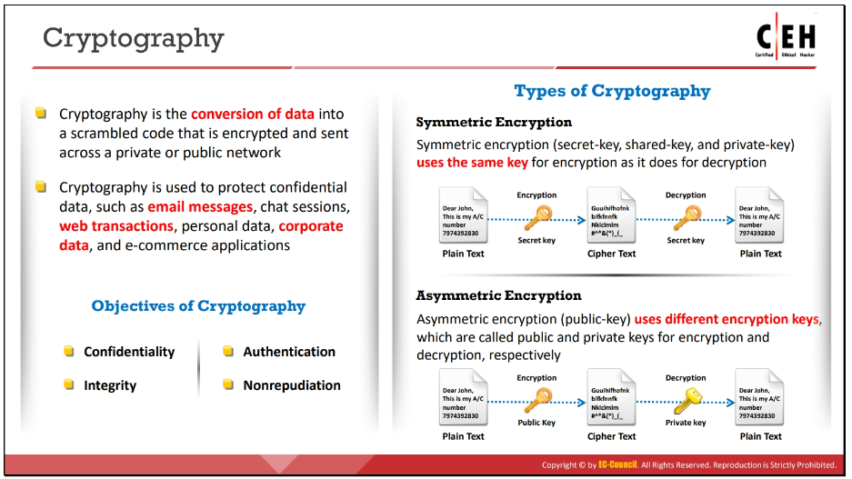
Cryptography Concepts
Notes:
“Cryptography” comes from the Greek words kryptos, meaning “concealed, hidden, veiled, secret, or mysterious,” and graphia, meaning “writing”; thus, cryptography is “the art of secret writing.”
Cryptography is the practice of concealing information by converting plaintext (readable format) into ciphertext (unreadable format) using a key or encryption scheme.
It is the process of converting data into a scrambled code that is encrypted and sent across a private or public network.
Cryptography protects confidential data such as email messages, chat sessions, web transactions, personal data, corporate data, e-commerce applications, and many other types of communication.
Encrypted messages can, at times, be decrypted by cryptanalysis (code breaking), even though modern encryption techniques are virtually unbreakable.

Slide 7
Objectives of Cryptography
Confidentiality: Assurance that the information is accessible only to those authorized to access it.
Integrity: Trustworthiness of data or resources in terms of preventing improper and unauthorized changes.
Authentication: Assurance that the communication, document, or data is genuine.
Nonrepudiation: Guarantee that the sender of a message cannot later deny having sent the message and that the recipient cannot deny having received the message.

Slide 8
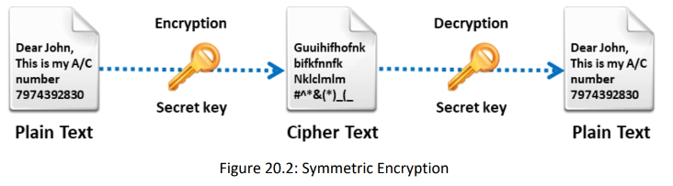
Types of Cryptography
Symmetric Encryption
Notes:
Symmetric Encryption Symmetric encryption requires that both the sender and the receiver of the message possess the same encryption key. The sender uses a key to encrypt the plaintext and sends the resultant ciphertext to the recipient, who uses the same key (used for encryption) to decrypt the ciphertext into plaintext. Symmetric encryption is also known as secret-key cryptography, as it uses only one secret key to encrypt and decrypt the data. This type of cryptography works well when you are communicating with only a few people. Because the sender and receiver must share the key before sending any messages, this technique is of limited use for the Internet, where individuals who have not had prior contact frequently require a secure means of communication. The solution to this problem is asymmetric encryption (public-key cryptography).

Slide 9
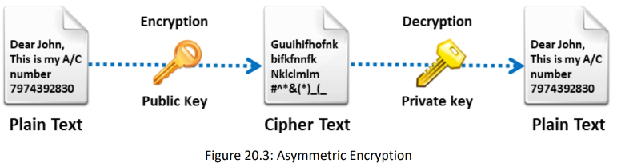
Types of Cryptography (cont’d)
Asymmetric Encryption
Notes:
Asymmetric Encryption
The concept of asymmetric encryption (also known as public-key cryptography) was introduced to solve key-management problems. Asymmetric encryption involves both a public key and a private key. The public key is publicly available, whereas the sender keeps the private key secret. An asymmetric-key system is an encryption method that uses a key pair comprising a public key available to anyone and a private key held only by the key owner, which helps to provide confidentiality, integrity, authentication, and nonrepudiation in data management.

Slide 10
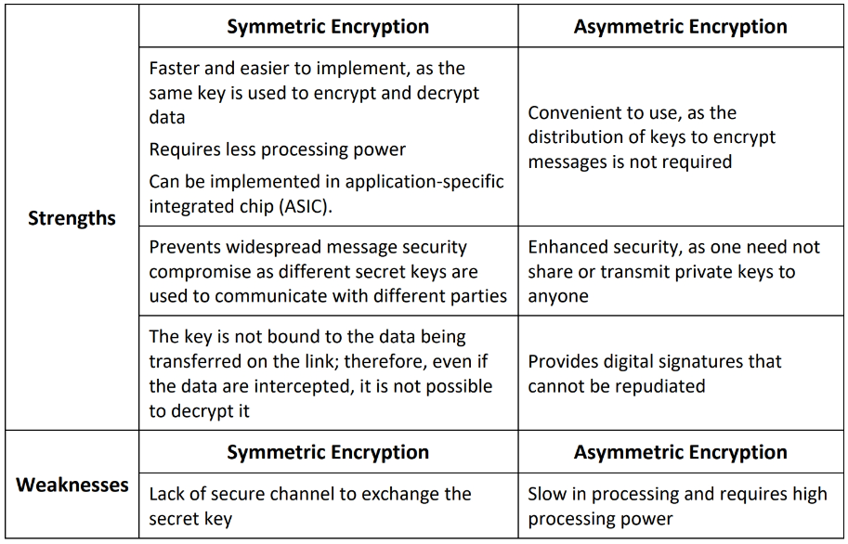
Strengths and Weaknesses of Crypto Methods

Slide 11
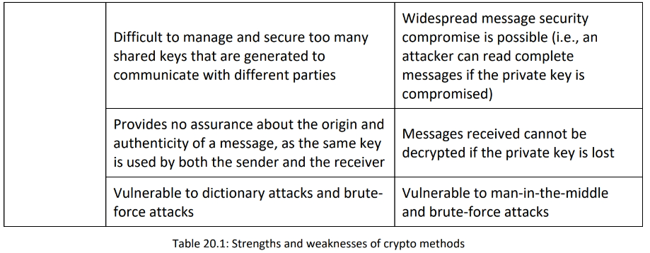
Strengths and Weaknesses of Crypto Methods (cont’d)

Slide 12
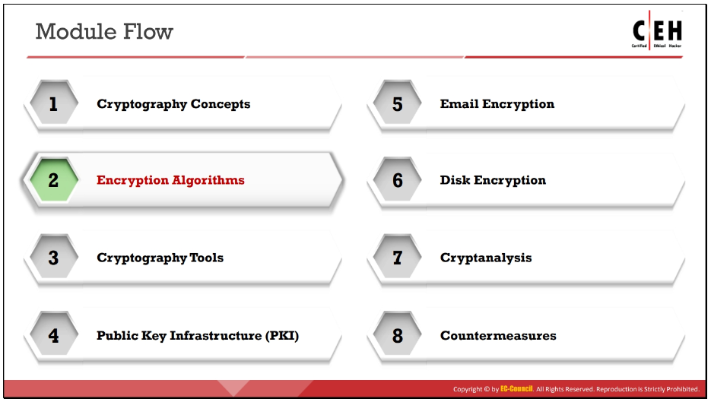
Module Flow
Notes:
Encryption Algorithms
Encryption is the process of converting readable plaintext into an unreadable ciphertext using a set of complex algorithms that transform the data into blocks or streams of random alphanumeric characters. This section deals with ciphers and various encryption algorithms such as DES, AES, RC4, RC5, RC6, DSA, RSA, MD5, SHA, etc

Slide 13
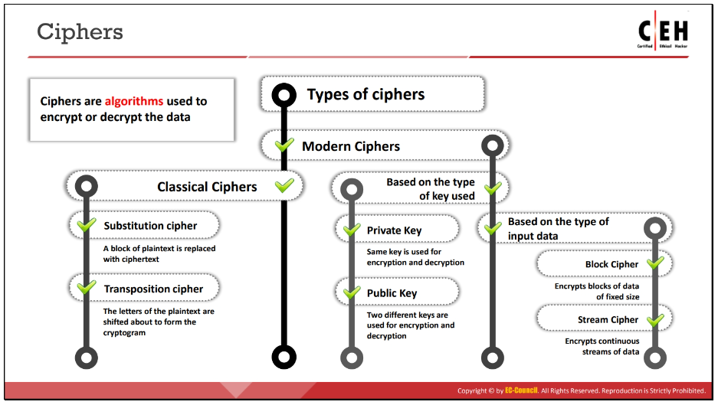
Ciphers
Notes:
Ciphers
In cryptography, a cipher is an algorithm (a series of well-defined steps) for performing encryption and decryption.
Encipherment is the process of converting plaintext into a cipher or code; the reverse process is called decipherment.
A message encrypted using a cipher is rendered unreadable unless its recipient knows the secret key required to decrypt it.
Communication technologies (e.g., Internet, cell phones) rely on ciphers to maintain both security and privacy.
Cipher algorithms may be open-source (the algorithmic process is in the public domain while the key is selected by a user and is private) or closed-source (the process is developed for use in specific domains, such as the military, and the algorithm itself is not in the public domain).
Furthermore, ciphers may be free for public use or licensed.

Slide 14
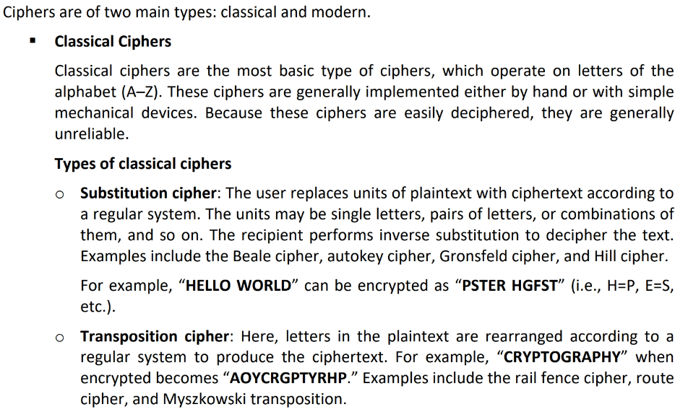
Ciphers (cont’d)

Slide 15
Ciphers (cont’d)
Modern Ciphers
Modern ciphers are designed to withstand a wide range of attacks. They provide message secrecy, integrity, and authentication of the sender. A user can calculate a modern cipher using a one-way mathematical function that is capable of factoring large prime numbers.
Types of Modern ciphers
Based on the type of key used
Symmetric-key algorithms (Private-key cryptography): Use the same key for encryption and decryption.
Asymmetric-key algorithms (Public-key cryptography): Use two different keys for encryption and decryption.
Based on the type of input data
Block cipher: Deterministic algorithms operating on a block (a group of bits) of fixed size with an unvarying transformation specified by a symmetric key. Most modern ciphers are block ciphers. They are widely used to encrypt bulk data. Examples include DES, AES, IDEA, etc. When the block size is less than that used by the cipher, padding is employed to achieve a fixed block size.
Stream cipher: Symmetric-key ciphers are plaintext digits combined with a key stream (pseudorandom cipher digit stream). Here, the user applies the key to each bit, one at a time. Examples include RC4, SEAL, etc.

Slide 16
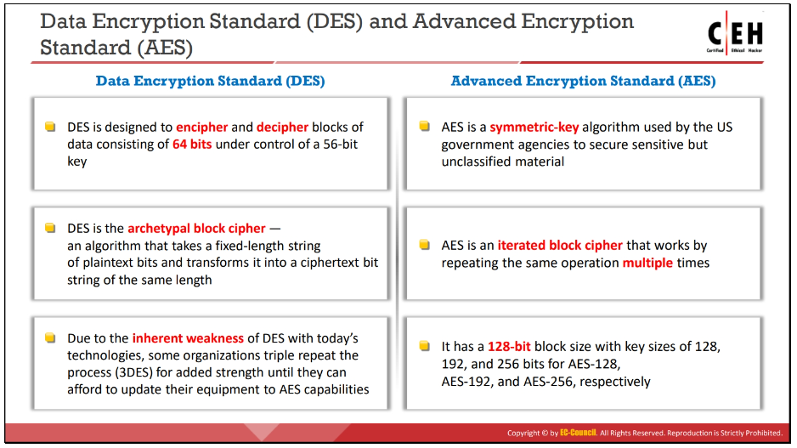
Data Encryption Standard (DES) & Advanced Encryption Standard (AES)
Notes:
Data Encryption Standard (DES)
DES is a standard for data encryption that uses a secret key for both encryption and decryption (symmetric cryptosystem). DES uses a 64-bit secret key, of which 56 bits are generated randomly and the other 8 bits are used for error detection. It uses a data encryption algorithm (DEA), a secret key block cipher employing a 56-bit key operating on 64-bit blocks. DES is the archetypal block cipher—an algorithm that takes a fixed-length string of plaintext bits and transforms it into a ciphertext bit string of the same length. The design of DES allows users to implement it in hardware and use it for single-user encryption, such as to store files on a hard disk in encrypted form. DES provides 72 quadrillion or more possible encryption keys and chooses a random key for the encryption of each message. Because of the inherent weakness of DES vis-à-vis today's technologies, some organizations use triple DES (3DES), in which they repeat the process three times for added strength until they can afford to update their equipment to AES capabilities.
Triple Data Encryption Standard (3DES)
Eventually, it became obvious that DES would no longer be secure. The U.S. Federal Government began a contest seeking a replacement cryptography algorithm. However, in the meantime, 3DES was created as an interim solution. Essentially, it performs DES three times with three different keys. 3DES uses a “key bundle” that comprises three DES keys, K1, K2, and K3. Each key is a standard 56-bit DES key. It then performs the following process: DES encrypt with K1, DES decrypt with K2, DES encrypt with K3 There are three options for the keys. In the first option, all three keys are independent and different. In the second option, K1 and K3 are identical. In the third option, all three keys are the same; therefore, you are literally applying the same DES algorithm three times with the same key. The first option is the most secure, while the third is the least secure.
Advanced Encryption Standard (AES)
The Advanced Encryption Standard (AES) is a National Institute of Standards and Technology (NIST) specification for the encryption of electronic data. It also helps to encrypt digital information such as telecommunications, financial, and government data. US government agencies have been using it to secure sensitive but unclassified material. AES consists of a symmetric-key algorithm: both encryption and decryption are performed using the same key. It is an iterated block cipher that works by repeating the defined steps multiple times. It has a 128-bit block size, with key sizes of 128, 192, and 256 bits for AES-128, AES-192, and AES-256, respectively. The design of AES makes its use efficient in both software and hardware. It works simultaneously at multiple network layers.

Slide 17
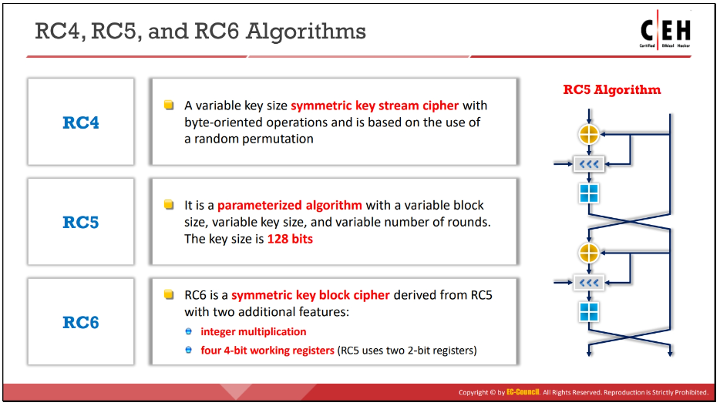
RC4, RC5, and RC6 Algorithms
Notes:
Symmetric encryption algorithms developed by RSA Security.

Slide 18
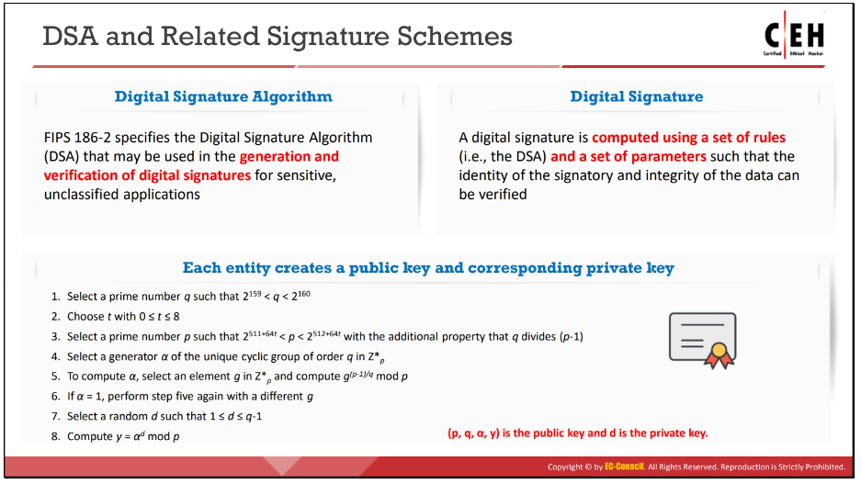
DSA and Related Signature Schemes
Notes:
DSA and Related Signature Schemes
The Digital Signature Algorithm (DSA) is a Federal Information Processing Standard for digital signatures. The NIST proposed the DSA for use in the Digital Signature Standard (DSS), adopted as FIPS 186. The DSA helps in the generation and verification of digital signatures for sensitive and unclassified applications. It creates a 320-bit digital signature with 512–1024-bit security. A digital signature is a mathematical scheme used for the authentication of digital messages. Computation of the digital signature uses a set of rules (i.e., the DSA) and a set of parameters in that the user can verify the identity of the signatory and the integrity of the data.

Slide 19
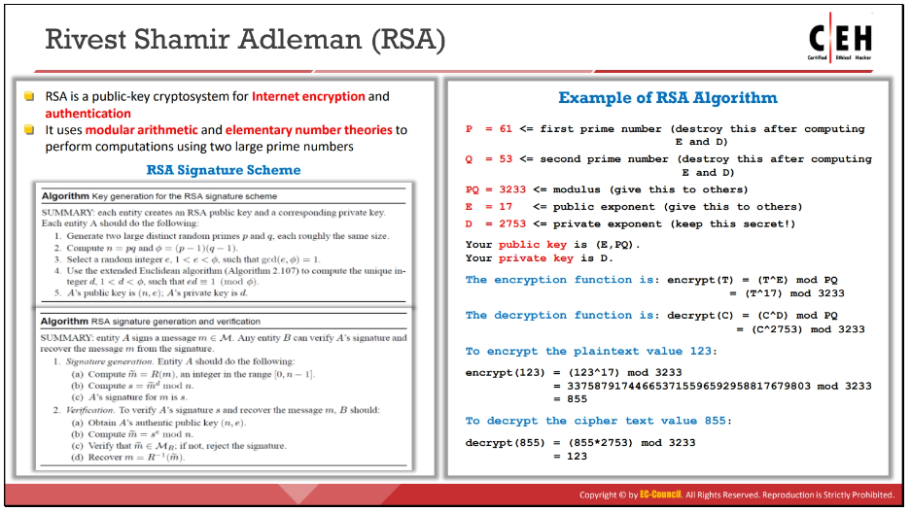
Rivest Shamir Adleman (RSA)
Notes:
Rivest Shamir Adleman (RSA)
Ron Rivest, Adi Shamir, and Leonard Adleman formulated RSA, a public-key cryptosystem for Internet encryption and authentication. RSA uses modular arithmetic and elementary number theories to perform computations using two large prime numbers. The RSA system is widely used in a variety of products, platforms, and industries. It is one of the de-facto encryption standards. Companies such as Microsoft, Apple, Sun, and Novell build RSA algorithms into their operating systems. RSA can also be found on hardware-secured telephones, Ethernet network cards, and smart cards.

Slide 20
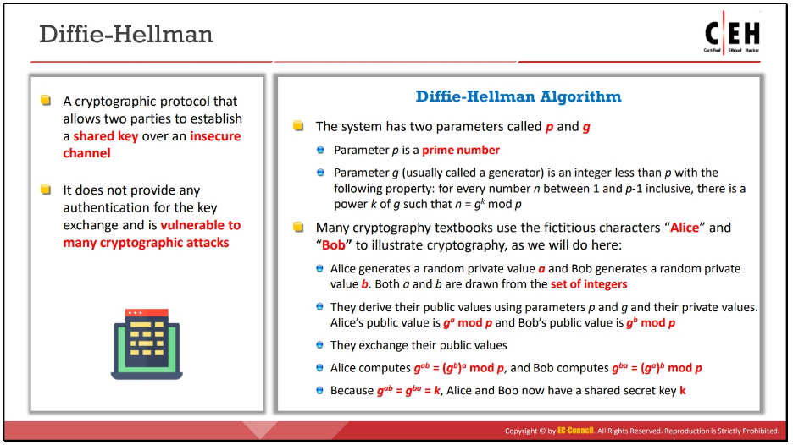
Diffie–Hellman
Notes:
Diffie–Hellman
It is a cryptographic protocol that allows two parties to establish a shared key over an insecure channel. It was developed and published by Whitfield Diffie and Martin Hellman in 1976. It was independently developed a few years earlier by Malcolm J. Williamson of the British Intelligence Service, but it was classified at that time.

Slide 21
Diffie-Hellman Mechanism
Diffie–Hellman key exchange is a cryptographic protocol that allows two parties that have no prior knowledge of each other to jointly establish a shared secret key over an insecure communications channel.
Firstly, Alice and Bob agree on two large prime numbers, n and g. These two integers need not be kept secret. Alice and Bob can use an insecure channel to agree on them.
Alice chooses another large random number x, and calculates A such that:
A = g^{x} mod n
Alice sends the number A to Bob.
Bob independently chooses another large random integer y and calculates B such that:
B = g^{y} mod n
Bob sends the number B to Alice.
A now computes the secret key K1 as follows:
K1 = B^{x} mod n
B now computes the secret key K2 as follows:
K2 = A^{y} mod n

Slide 22
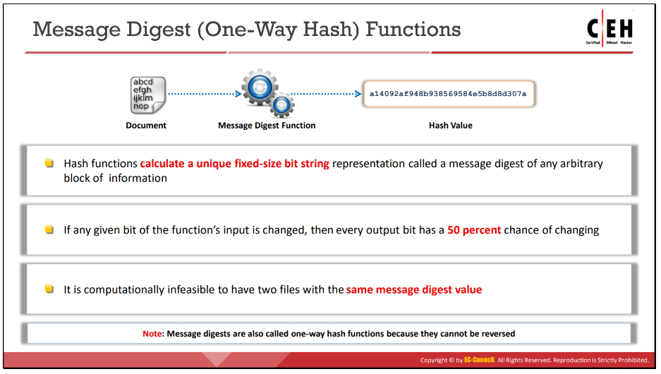
Message Digest (One-way Hash)
Notes:
Message Digest (One-way Hash)
Functions Hash functions calculate a unique fixed-size bit string representation, called a message digest, of any arbitrary block of information. Message digest functions distill the information contained in a file (small or large) into a single fixed-length number, typically between 128 and 256 bits. If any given bit of the function’s input is changed, every output bit has a 50% chance of changing. Given an input file and its corresponding message digest, it should be nearly impossible to find another file with the same message digest value, as it is computationally infeasible to have two files with the same message digest value.

Slide 23
Message Digest (One-way Hash) (cont’d)
Widely used message digest functions include the following algorithms:
MD5
SHA
Note: Message digests are also called one-way hash functions because they cannot be reversed.

Slide 24
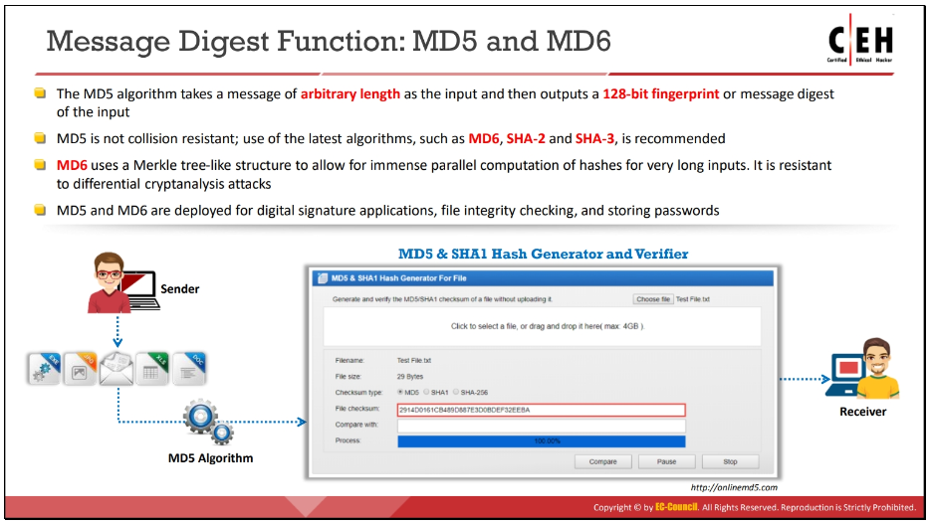
Message Digest Function: MD5 and MD6

Slide 25
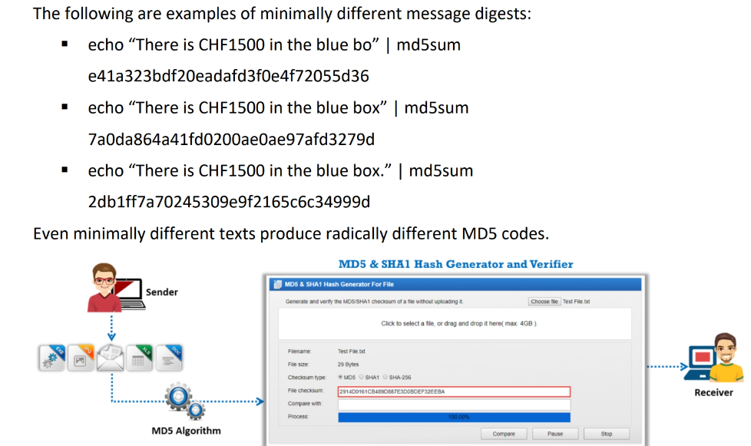
Message Digest Function: MD5 and MD6 (cont’d)

Slide 26
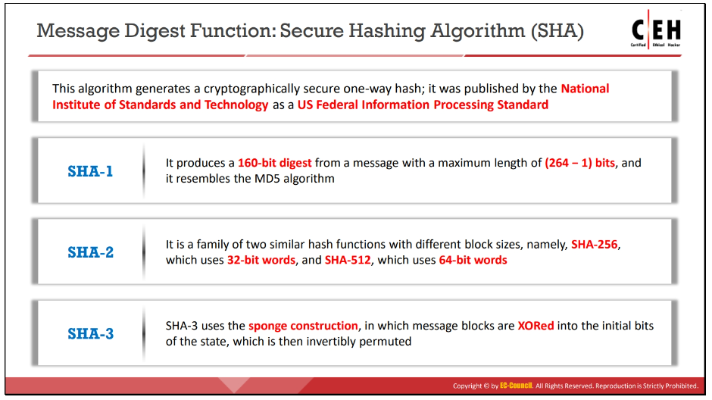
Message Digest Function: SHA

Slide 27
Quick Review Question
What is cryptography?
What are the main types of encryption?
What is hashing? And how hashing is used in data hiding?

Slide 28
Summary of Main Teaching Points
Cryptography
Symmetric encryption
Asymmetric encryption
Hashing

Slide 29
Question and Answer Session
Q & A

Slide 30
What we will cover next
Steganography

Slide 31
Today’s Lab Exercise:
Describes man-in-the-middle attack on Diffie-Hellman Key Exchange with an example.
How to prevent it?

